Slide 1
EURUSD&USDCHF LSTM
Feature Eng Summer 2020
Yiming Ge

Slide 2
DATA PREPARATION
Get the data from yfinance
[USDCHF 2019-07-01 to 2020-07-01] & [EURUSD 2019-07-01 to 2020-07-01]
Using class4.py
Select the best short term lag(based on return) among 22~31
Select the best long term lag(based on energy) among150~210
EURUSD: short – 27 days, long – 180 days
USDCHF: short – 27 days, long – 160 days

Slide 3
DATA PREPARATION
Using data-PRE.py
Load the data and calculate the features based on selected rolling windows
Column names:
Date; EURUSD=X or USDCHF=X; S&P
STD; Vol_global; Vol_local; return; Price_MA; Primary risk
FD; Energy; Correlation
STD_short; Price_LB; Price_UB; Price_LB_Price_UB_Distance; Distance_MA

Slide 4
DATA PREPARATION
EURUSD_FULL_DATA.csv & USDCHF_FULL_DATA.csv
Drop all the NULL value and only use full information with each feature.
EURUSD_FULL_DATA: 75 days data start from 3/19/2020 to 7/01/2020
USDCHF_FULL_DATA: 95 days data start from 2/20/2020 to 7/01/2020
Train: First 53 days [:53]
Test: Remaining days [53:]
Note: Due to equipment limitations, I used these small data to train and test model. 53 days data are obviously not large enough to train a perfect neural network model but still able to get some interesting founds.

Slide 5
FEATURES SELECTION
Using select feature.py
Three different ways to select features for both currency pairs:
1. ANOVA F-TEST FEATURE SELECTION(based on f-regression)
2. Mutual Information Feature Selection(based on mutual_info_regression)
3. Shap (based on RandomForestRegressor)

Slide 6
LSTM VISUALIZATION
Using LSTM VISU EURUSD.py & LSTM VISU USDCHF.py
Each currency pair has 11 different LSTM models
Univariate LSTM Models: 1. Vanilla LSTM 2. Stacked LSTM 3. Bidirectional LSTM
4.CNN LSTM 5.Conv LSTM
Multi-Step LSTM Models: 6. Vector Output Model 7.Encoder-Decoder Model
Multivariate LSTM Models 8. Multiple Input Series with all features 9. Multiple Input Series with selected features
Multivariate Multi-Step LSTM Models: 10.Multiple Input Multi-Step Output with all features 11. Multiple Input Multi-Step Output with selected features
.

Slide 7
EURUSD LSTM VISUALIZATION
Univariate LSTM Models
1. Vanilla LSTM
2. Stacked LSTM
3. Bidirectional LSTM
4.CNN LSTM
5.Conv LSTM

Slide 8
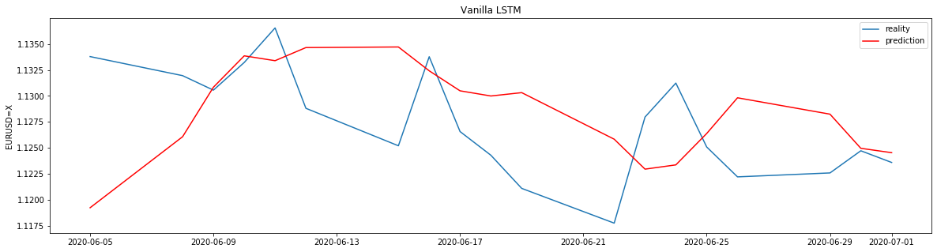

VANILLA LSTM

Slide 9
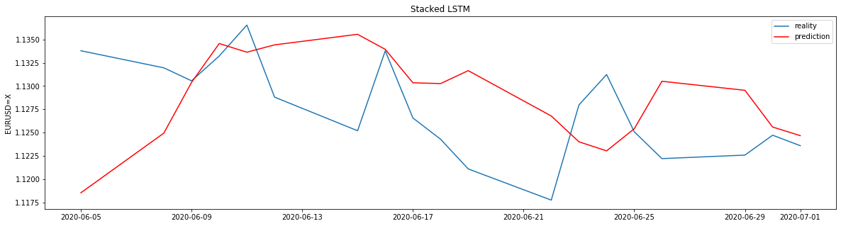
STACKED LSTM

Slide 10
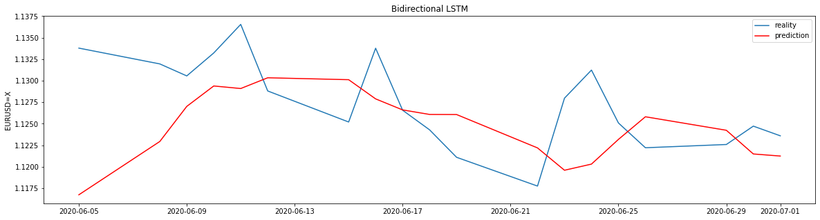
BIDIRECTIONAL LSTM

Slide 11
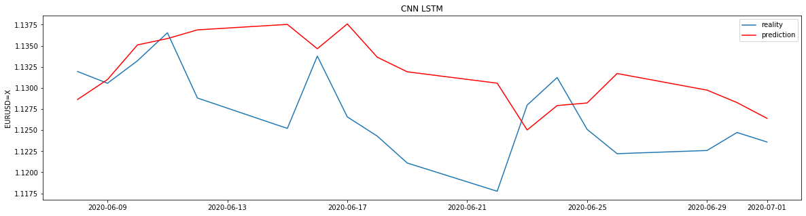
CNN LSTM

Slide 12
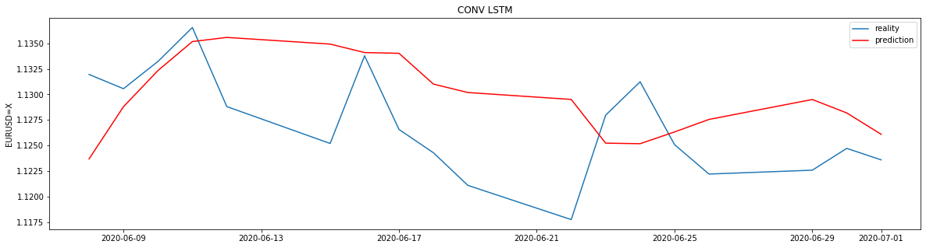
CONV LSTM

Slide 13
EURUSD LSTM VISUALIZATION
Multi-Step LSTM Models:
6. Vector Output Model
7.Encoder-Decoder Model

Slide 14
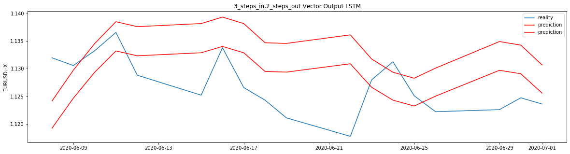
VECTOR OUTPUT LSTM

Slide 15
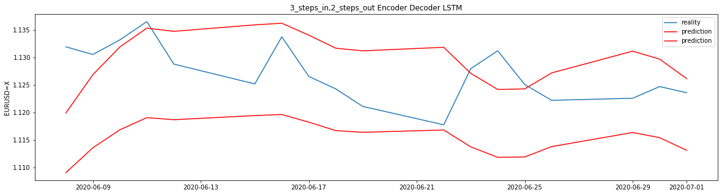
ENCODER DECODER LSTM

Slide 16

FEATURES IMPORTANCE
Before doing multivariate lstm models, we should check our feature importance first.

Slide 17
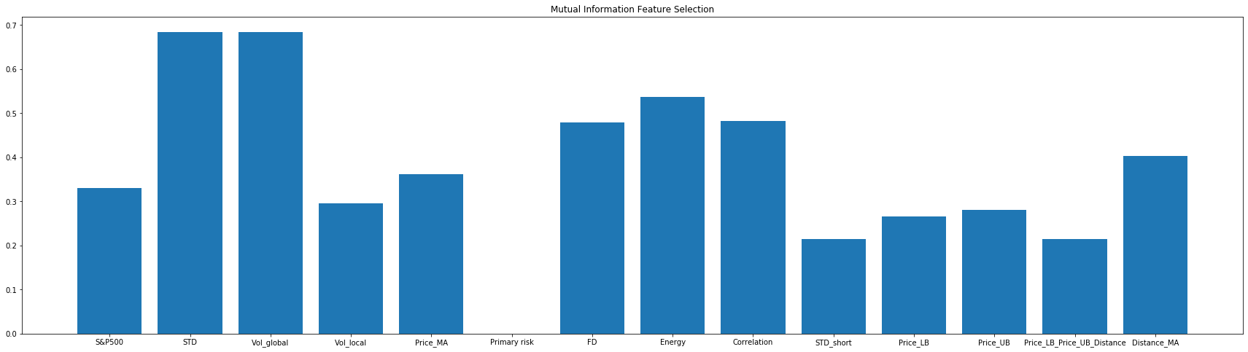
MUTUAL INFORMATION

Slide 18
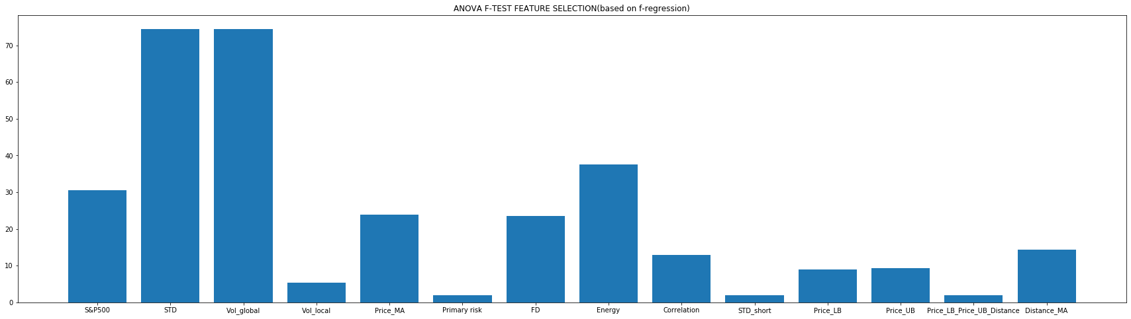
F-TEST

Slide 19
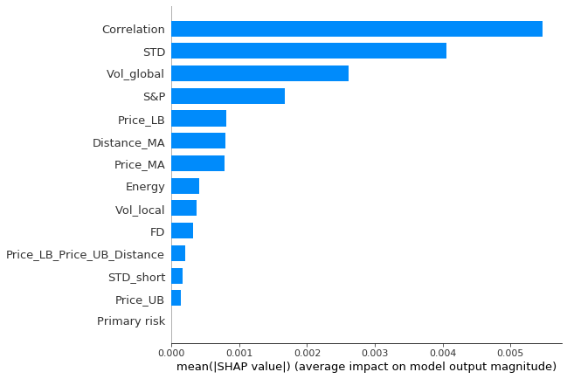
SHAP

Slide 20
SELECTED FEATURES
BASED ON ABOVE TESTS
FOR SELECTED FEATURES, I WILL DROP
‘VOL_LOCAL’
‘PRIMARY RISK’
‘STD SHORT’
'Price_LB_Price_UB_Distance'

Slide 21
EURUSD LSTM VISUALIZATION
Multivariate LSTM Models
8. Multiple Input Series with all features
9. Multiple Input Series with selected features

Slide 22
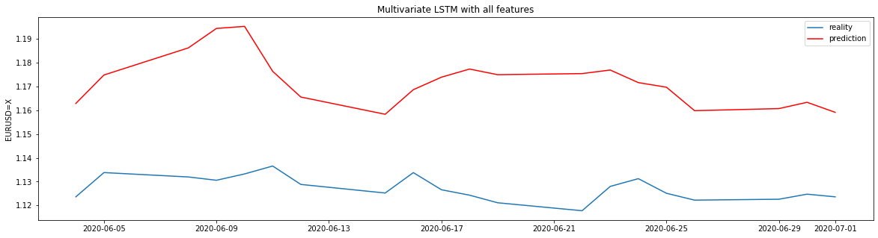
WITH ALL FEATURES

Slide 23
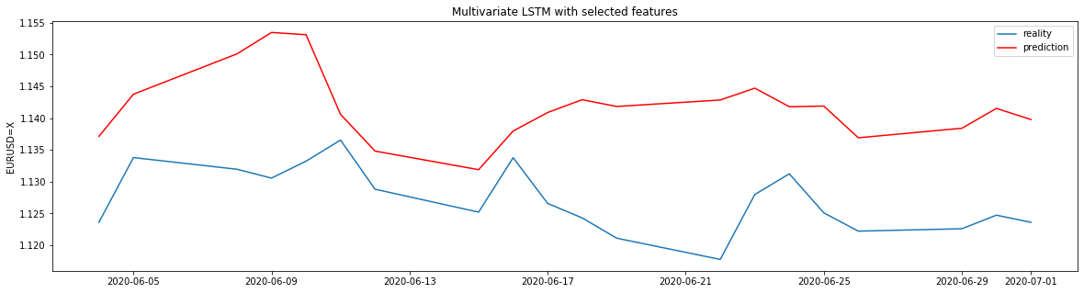
WITH SELECTED FEATURES

Slide 24
EURUSD LSTM VISUALIZATION
Multivariate Multi-Step LSTM Models:
10.Multiple Input Multi-Step Output with all features
11. Multiple Input Multi-Step Output with selected features

Slide 25
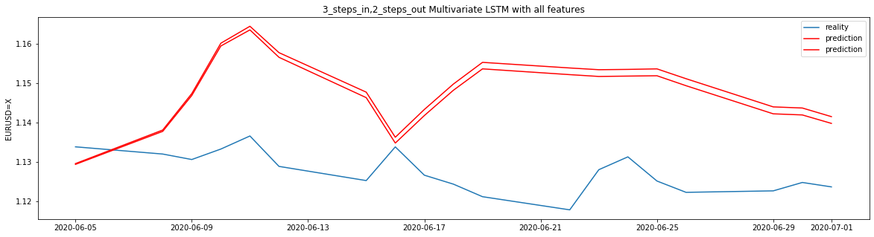
WITH ALL FEATURES

Slide 26
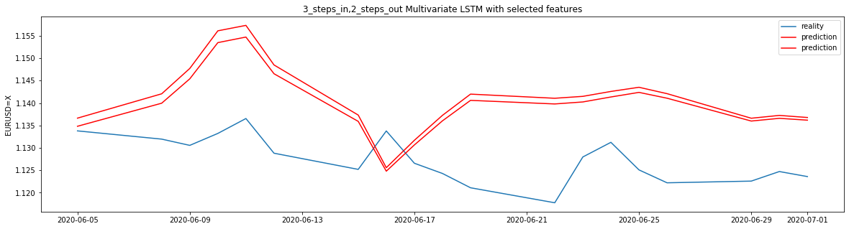
WITH SELECTED FEATURES

Slide 27
USDCHF LSTM VISUALIZATION
SAME DISPLAYING ORDER WITH EURUSD PART

Slide 28
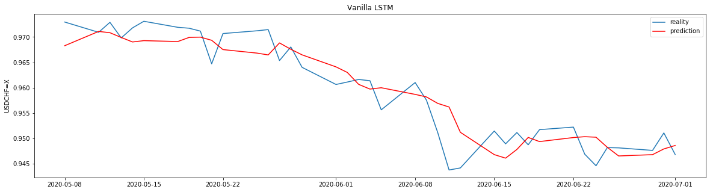
VANILLA LSTM

Slide 29
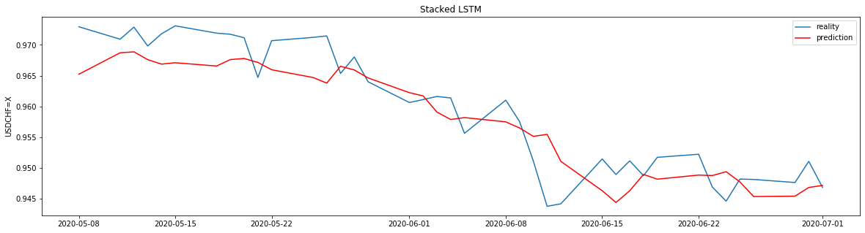
STACKED LSTM

Slide 30
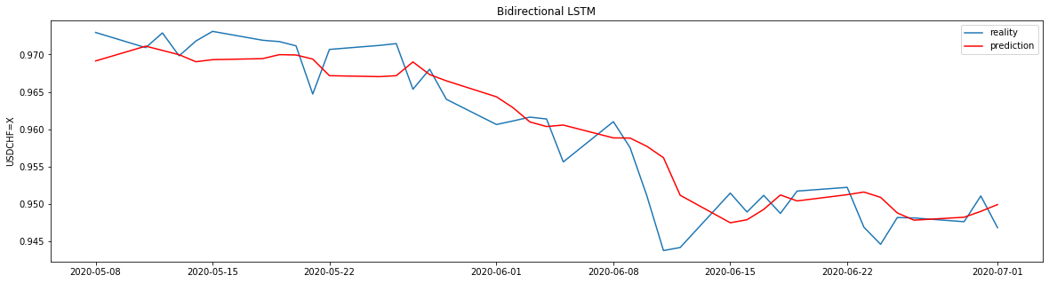
BIDIRECTIONAL LSTM

Slide 31
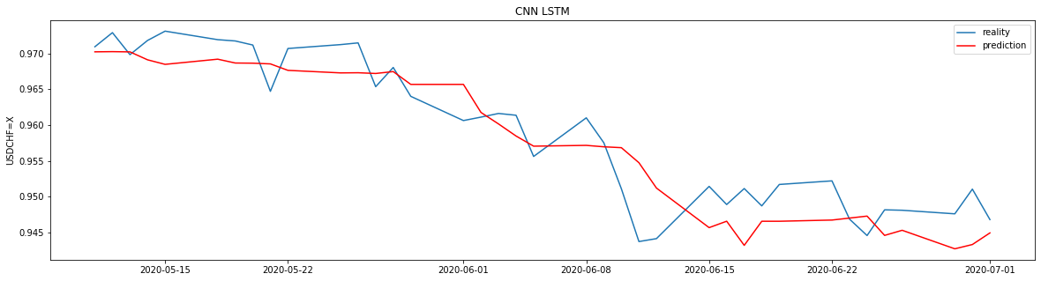
CNN LSTM

Slide 32
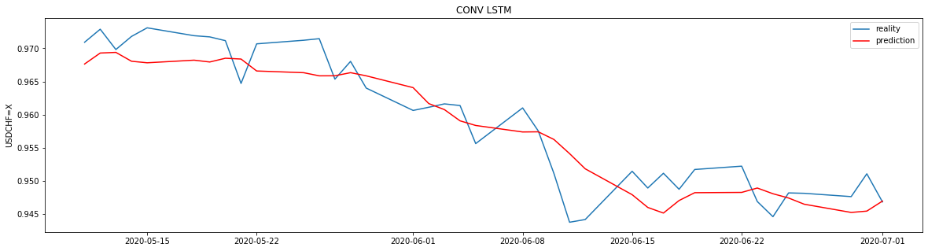
CONV LSTM

Slide 33
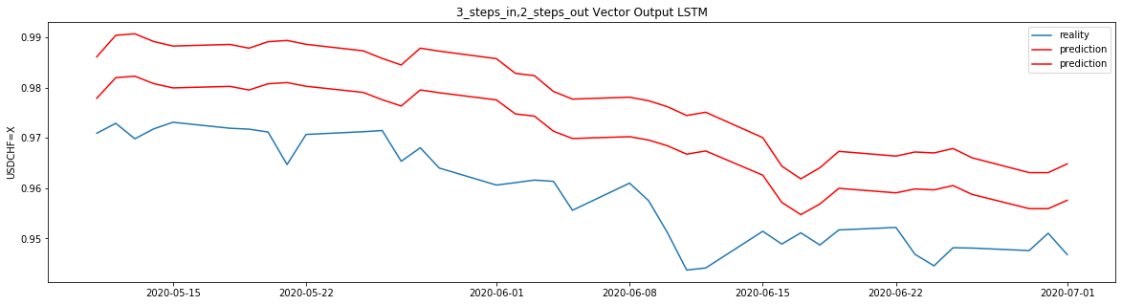
VECTOR OUTPUT LSTM

Slide 34
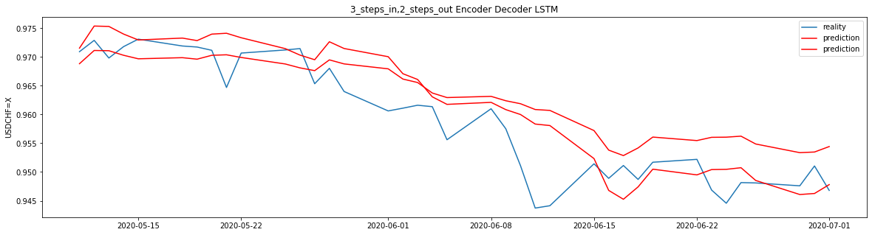
ENCODER DECODER LSTM

Slide 35
FEATURES IMPORTANCE
Before doing multivariate lstm models, we should check our feature importance first.

Slide 36
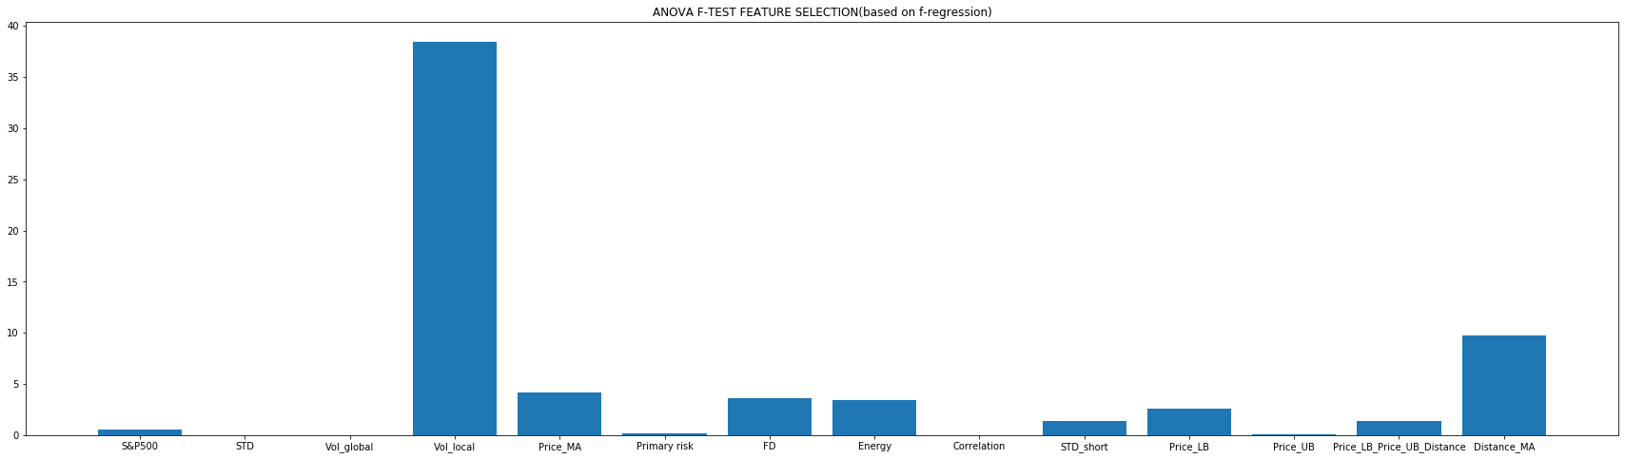
F-TEST

Slide 37
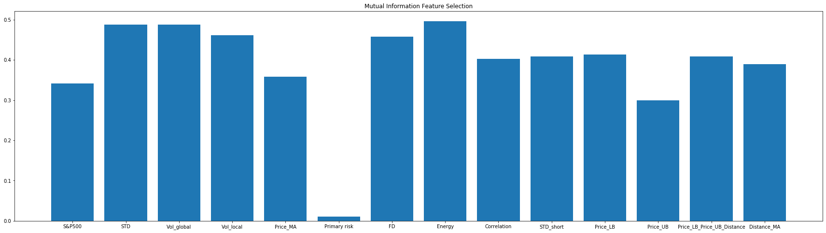
MUTUAL INFORMATION

Slide 38
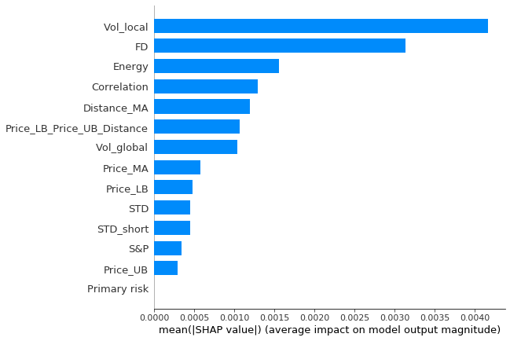
SHAP

Slide 39
FEATURES SELECTION
BASED ON ABOVE TESTS
FOR SELECTED FEATURES, I WILL CHOOSE
‘VOL_LOCAL’
‘FD’
‘ENERGY’
'Distance_MA'

Slide 40
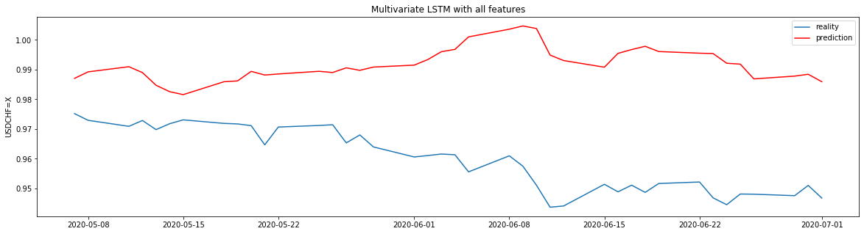
WITH ALL FEATURES

Slide 41
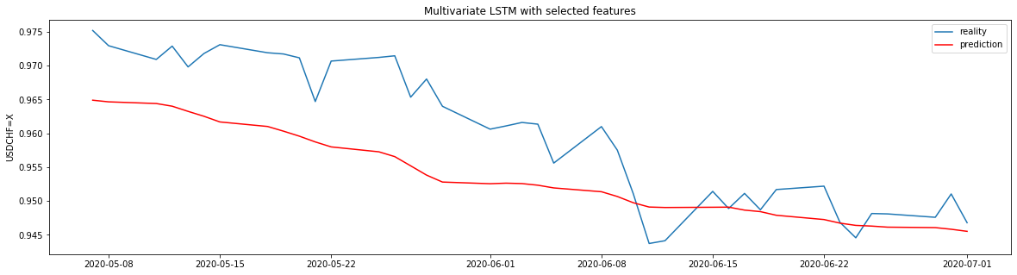
WITH SELECTED FEATURES

Slide 42
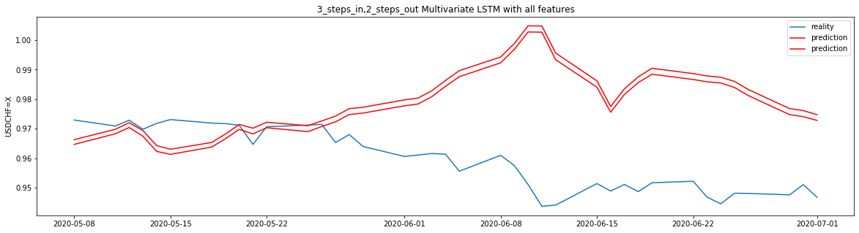
WITH ALL FEATURES

Slide 43
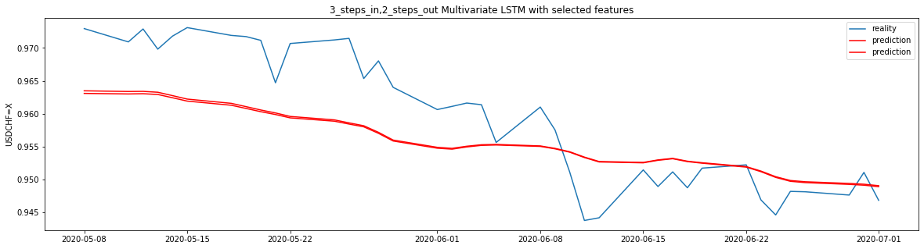
WITH SELECTED FEATURES

Slide 44

CONCLUSION
In my opinion, the essential of any trading market is about the trend.
We don’t need to predict the exact point. We only need to predict the trend in a specific period to make the money.
Without a very obvious trend we can find local highest point and local lowest point to make money[eg. EURUSD]
With very obvious trend we can buy put or call options to make money easily[eg. USDCHF buy put]

Slide 45


THANK YOU
https://machinelearningmastery.com/how-to-develop-lstm-models-for-time-series-forecasting/
https://machinelearningmastery.com/feature-selection-for-regression-data/
https://github.com/slundberg/shap
https://towardsdatascience.com/explain-your-model-with-the-shap-values-bc36aac4de3d

